Slide 1
International Migration 2020: Highlights
The number of international migrants worldwide has continued to grow (from 175 mln in 2000 until 283 mln in 2020), but has slowed owing to the COVID-19 pandemic;
Forced migration across international borders continued to grow (Between 2000 and 2020, the number of people forcibly displaced across international borders doubled from 17 to 34 million, representing about 16 percent of the total growth in the number of international migrants worldwide during this period.
Most of the world's refugees are in low- and middle-income countries;
Almost two thirds of all international migrants live in high -income countries;
The majority of international migrants in the world live in a small number of countries; in 2020, two-thirds of all international migrants lived in just 20 countries

Slide 2
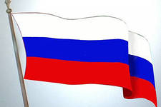
Countries with the largest number of migrants in 2015 in 2020
44 mln 51 mln (18%)
11 mln 16 mln (6%)
9,8 mln 13 mln (5%))
9,1 mln 12mln (4%)
7,8 mln 9 mln (3%)

Slide 3
International Migration 2020: Highlights 2
International migration often remains within the main regions (In 2020, nearly half of all international migrants at the global level were living in their region of origin. E.g. Europe had the largest share of intra-regional migration, with 70 per cent of all migrants born in Europe residing in another European country or area ;
Women and girls make up 48 percent of all international migrants;
International migrants, as a rule, are of working age (In 2020, 73 percent of all international migrants were between the ages of 20 and 64 , while the share of the world's population in this age group was 57 percent);
Most countries have policies aimed at promoting orderly, safe, legal and responsible migration
Prepared by the Population Division of the United Nations Department of Economic and Social Affairs

Slide 4
Russian migration legislation over the past five years. Legal regimes established in relation to foreign citizens.

Slide 5
LEGAL REGIME
- rights and obligations of foreign citizens and stateless persons established by the national legislation and international treaties of the host country.

Slide 6
Issues regulated by the migration legislation of Russia
The order of entry into and exit from the Russian Federation
The order of stay, residence on the territory of the Russian Federation
The procedure for carrying out labor activity in the Russian Federation
The procedure for granting asylum in the Russian Federation
Procedure for acquiring citizenship of the Russian Federation

Slide 7
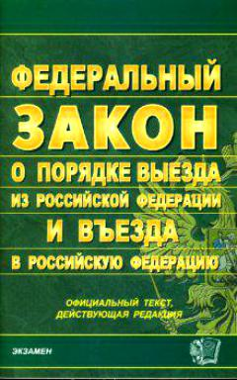
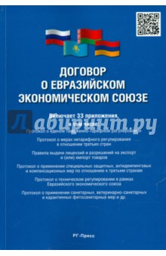
Federal Law 114 «On the procedure for leaving the Russian Federation and entering the Russian Federation»
Federal Law 115 «On the legal status of foreign citizens in the Russian Federation»
Federal Law 109 «On migration registration of foreign citizens and stateless persons in the Russian Federation»
Labour Code. chapter 50.1: Peculiarities of labor regulation of employees who are foreign citizens or stateless persons
Federal Law 62 “On Citizenship of the RF”
Treaty on the Eurasian Economic Union (signed in Astana on 29.05.2014)

Slide 8
THE CONCEPT OF THE STATE MIGRATION POLICY OF THE RUSSIAN FEDERATION FOR THE PERIOD UP TO 2025(2019)
Russian Federation aims to create a situation that "contributes to solving problems in the field of 1) socio-economic, 2) spatial and 3) demographic development of the country, 4) improving the quality of life of its population, 5) ensuring state security, 6) protecting the national labor market, 7) maintaining interethnic and interreligious peace and harmony in Russian society, as well as 8) in the field of protection and preservation of Russian culture, the Russian language and the historical and cultural heritage of the peoples of Russia, which form the basis of its cultural (civilizational) code
Differentiated approach to different categories of foreign citizens - compatriots and labor migrants

Slide 9
A foreign citizen temporarily staying in the Russian Federation is a person who arrived in the Russian Federation on the basis of a visa, or in a manner that does not require a visa and has received a migration card (who does not have a temporary residence permit or a residence permit)
A foreign citizen temporarily residing in the Russian Federation is a person who has received a temporary residence permit in the Russian Federation (3 years)
A foreign citizen permanently residing in the Russian Federation is a person who has received a residence permit in the Russian Federation (for an indefinite period)

Slide 10
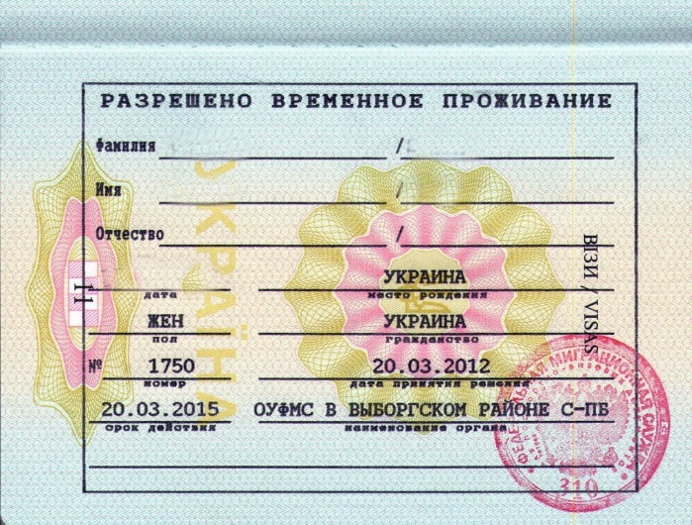
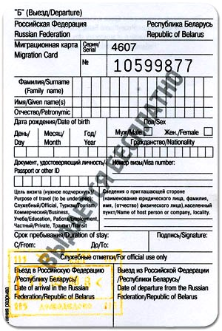
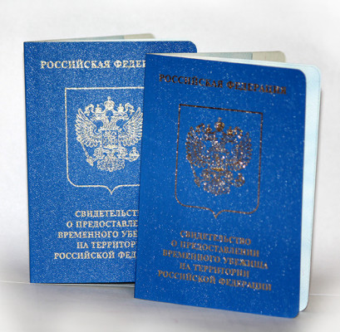
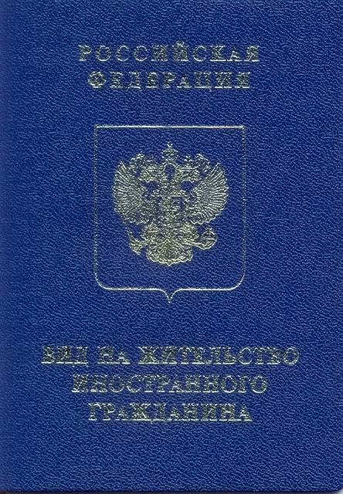
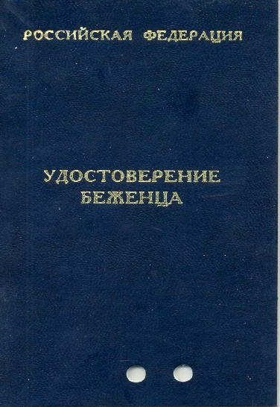
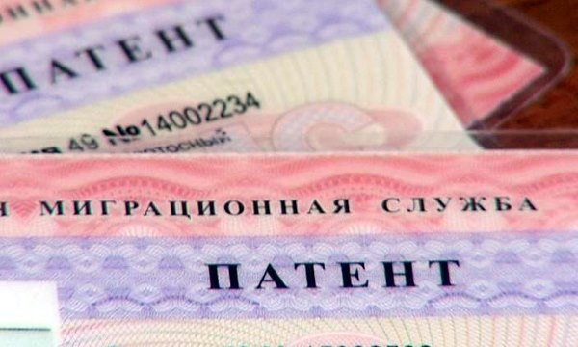
What document entitles you to temporary stay in Russia?

Slide 11
Visa entry procedure
Entry procedure that does not require a visa
Identity document and migration card issued by border control authorities
The visa is issued on the basis of an invitation to enter the Russian Federation, issued on the initiative of the inviting party
private
tourist
work
study
The period of stay is determined by the validity of the visa
Duration of stay
90 days in total during each period of 180 days
Work permit
(1 year)
Patent (work permit)
(for a period of 1 to 12 months, extended by the payment of personal income tax in the form of a fixed advance payment)

Slide 12
Taking into account the quota
(established by the Decree of the Government of the Russian Federation)
Temporary residence permit in the Russian Federation
(a mark in the passport, a separate document for stateless person)
Without quota
(п.3 ст.6 115-Federal Law)
Without the quota approved by the Government of the Russian Federation, a temporary residence permit may be issued to a foreign citizen:
to whom a residence permit is issued without obtaining a temporary residence permit;
who has not reached the age of 18 and whose parent (adoptive parent, guardian, trustee) is a foreign citizen and temporarily resides in the Russian Federation - for the period of temporary residence of his parent (adoptive parent, guardian, trustee);
who married to a citizen of the Russian Federation who has a place of residence in the Russian Federation;
who is a participant in the State Program to assist the Voluntary Resettlement to the Russian Federation of compatriots Living Abroad, and members of his family who are resettling together with him to the Russian Federation;
who is a citizen of a state that was part of the USSR and has received professional education in a state educational organization of higher education, a state professional educational organization or a state scientific organization located on the territory of the Russian Federation, according to state-accredited educational programs;
who is a citizen of the Republic of Kazakhstan, the Republic of Moldova or Ukraine;
a stateless person who has a temporary identity card of a stateless person in the Russian Federation, as well as a stateless person who has permanently resided on the territory of Ukraine, recognized as a refugee or received temporary asylum in the territory of the Russian Federation; and others.

Slide 13
Temporary residence permit in the Russian Federation
(a mark in the passport, a separate document for stateless person)
The validity period of the temporary residence permit is three years.
There is no possibility to extend the TRP after three years, therefore, during this period, a foreign citizen must decide what he is doing, apply for a residence permit in Russia or apply for citizenship of the Russian Federation.

Slide 14
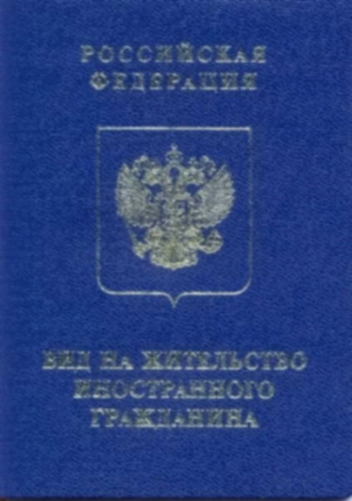
Foreign citizen recognized as a native speaker (носитель) of the Russian language
(without providing a TRP)
If you have a temporary residence permit
(the period of residence under the TRP
is at least 8 months)
Residence permit in the Russian Federation
(separate document)
Foreign citizens who arrived in the Russian Federation in an emergency mass order, recognized as refugees or who received temporary asylum on the territory of the Russian Federation and became participants in the State Program to assist the voluntary resettlement of compatriots living abroad to the Russian Federation, as well as their family members who resettled together
(without providing a TRP)
Citizen of the Republic of Belarus
(without providing a TRP)
Highly qualified specialists and their family members
(without providing a TRP)

Slide 15
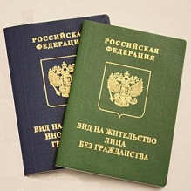
Permanently residing person- is a person who has residence permit;
Permanent residence is a document that gives the right to foreign citizens and stateless persons to live and work legally on the territory of the Russian Federation for a long time. After obtaining a residence permit, a foreign citizen receives the status of permanent resident in the country.
Since November 1, 2019, a residence permit for an indefinite period has been introduced for most categories of foreign citizens.
You will need to change your residence permit at the age of 14, 20 and 45, as well as when changing your name or when the document is damaged.

Slide 16
residence permit may be issued to a foreign citizen who has lived in the Russian Federation for at least one year on the basis of a temporary residence permit.
Simplified procedure for obtaining a residence permit without getting TRP
a foreign citizen who was born in the territory of the RSFSR and was formerly a citizen of the USSR;
a foreign citizen who has a parent (adoptive parent, guardian, trustee), a son or daughter who are citizens of the Russian Federation and permanently residing in the Russian Federation;
a foreign citizen recognized as a native speaker of the Russian language in accordance with Article 33.1 of Federal Law No. 62-FZ of May 31, 2002 "On Citizenship of the Russian Federation;
a highly qualified specialist and his family members in accordance with Article 13.2 of this Federal Law;
a foreign citizen who has carried out at least six months prior to the date of applying for a residence permit working in the Russian Federation by profession (specialty, position) included in the list of professions (specialties, positions) of foreign citizens and stateless persons - qualified specialists who have the right to receive citizenship of the Russian Federation in a simplified manner;
a foreign citizen who has successfully completed a state-accredited full-time educational program of higher education in the Russian Federation and has received a certificate of education and qualifications with honors; and others

Slide 17
Citizenship of the Russian Federation
Issuance of a TRP for the validity period of the certificate
Issuance of permanent residence
Issuance of a residence permit for 3 years
Issuance of the residence permit (for an indefinite period)
Participation in the State program to assist the voluntary resettlement of compatriots living abroad and their family members to the Russian Federation
(issuance of the certificate of the State program participant)
Recognition as a native speaker of the Russian language (residence of a relative in a direct ascending line in the Russian Federation earlier or in the present bp., or residence of the citizen himself)
Temporary residence permit
On the territory of the Russian Federation
Outside the Russian Federation
On the territory of the Russian Federation
Outside the Russian Federation
Quota
Without quota
TRP
PR
TA
Refugee

Slide 18
Admission to the citizenship of the Russian Federation in the general order
If a foreign citizen resides on the territory of the Russian Federation from the date of obtaining a residence permit until the date of applying for citizenship of the Russian Federation for five years continuously, except for the cases provided for in part two of this article (13). The period of residence on the territory of the Russian Federation is considered continuous if the person has left the Russian Federation for no more than three months within one year.
Admission to citizenship of the Russian Federation in a simplified manner
Foreign citizens and stateless persons permanently residing in the territory of the Russian Federation have the right to apply for citizenship of the Russian Federation in a simplified manner (without 5 years of residence):
they were born on the territory of the RSFSR and had citizenship of the former USSR;
they have been married for at least three years to a citizen of the Russian Federation residing in the territory of the Russian Federation;
have a capable son or daughter who have reached the age of eighteen and are citizens of the Russian Federation;
After July 1, 2002, they received professional education according to educational programs of secondary vocational education, bachelor's degree programs, specialty programs, master's degree programs, assistant internship programs that have state accreditation, or according to programs for training scientific and scientific-pedagogical personnel in postgraduate studies (adjunct) in educational or scientific organizations of the Russian Federation on its territory and carry out labor activity in the Russian Federation in aggregate for at least one year until the day of applying for citizenship of the Russian Federation. At the same time, during the specified period, in respect of such foreign citizens and stateless persons, the employer must have accrued insurance contributions to the Pension Fund of the Russian Federation;

Slide 19
Admission to citizenship of the Russian Federation in a simplified manner (continued)
e) They are individual entrepreneurs and carry out entrepreneurial activity in the Russian Federation continuously for at least three years preceding the year of applying for citizenship of the Russian Federation in the types of economic activity established by the Government of the Russian Federation;
f) have at least one parent who has the citizenship of the Russian Federation and lives on the territory of the Russian Federation;
g) they are citizens of the Republic of Belarus, the Republic of Kazakhstan, the Republic of Moldova or Ukraine;
h) carry out at least one year before the date of application for admission to citizenship of the Russian Federation labor activity in the Russian Federation by profession (specialty, position) included in the list of professions (specialties, positions) of foreign citizens and stateless persons - qualified specialists who have the right to admission to citizenship of the Russian Federation in a simplified manner…
A foreign citizen or a stateless person temporarily or permanently residing in the territory of the Russian Federation has the right to apply for citizenship of the Russian Federation in a simplified manner without observing the condition on the period of residence established by paragraph "a" of part one of Article 13 of this Federal Law, and without observing the condition established by paragraph "b" of part one of Article 13 of this Federal Law, if the specified citizen or the specified person is married to a citizen of the Russian Federation residing in the territory of the Russian Federation and has children in this marriage.

Slide 20
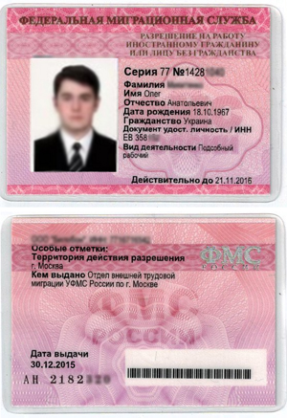
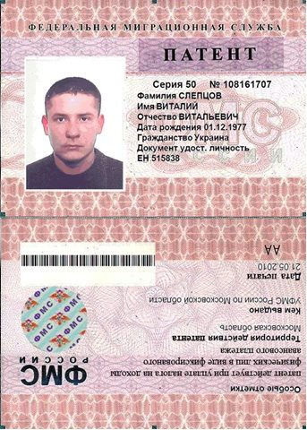
Labour migrants
Work permit
Work patent

Slide 22
Foreign citizens temporarily staying on the territory of the Russian Federation on the basis of visas.
documents confirming the status, the right to work - work permit, visa, migration card
additionally, the employer needs permission to attract and use foreign workers.
they have the right to carry out labor activity only with work visa (Regulations on the procedure for issuing a visa, approved. Decree of the Government of the Russian Federation No. 335 of 09.06.2003)
tourist, private and other types of visas do not give the right to a foreign citizen to work.
The visa is issued on the basis of an invitation to enter the Russian Federation, which is issued on the initiative of the future employer.
A foreign citizen has the right to work only in the territory of the region where a work permit has been issued, and only in the specialty specified in the work permit.

Slide 23
Foreign citizens temporarily staying on the territory of the Russian Federation in a manner that does not require a visa:
to obtain a work patent, a foreign citizen must apply to the migration service authorities within 30 calendar days from the date of entry into the Russian Federation
the migration card indicates "work" as the purpose of entry.
documents confirming the right to work:
Patent:
Documents on making advance payments:
Migration card:
Migration registration

Slide 24
Simplified procedure for employment of foreign citizens studying in Russia from August 5, 2020
Foreign citizens can work in Russia without additional permits (work permit / work patent) if:
they are full-time students;
they study in professional educational organizations and educational institutions of higher education;
they study according to an educational program with state accreditation;
in free time from studying.

Slide 25
The amount of the collected advance tax to the regional budgets
2014 17,9 billion roubles
2015 33,3 bln
2016 44,9 (Moscow – 14 bln, SPb - 6 bln)
2017 51 bln
2018 57 bln roubles (Moscow – 17 bln, SPb – 6,5 bln roubles)
2019 60,4 bln
2020 47,5 bln

Slide 26
Who has the right to work in the Russian Federation without a patent
Persons permanently residing in the Russian Federation
Persons recognized as refugees in the territory of the Russian Federation
Persons who have received temporary asylum in the Russian Federation
Persons temporarily residing in the Russian Federation
Citizens of the member States of the Eurasian Economic Union
Participants of the State Program on voluntary resettlement and their family members

Slide 27
Thank you for your attention!
N.Zaibert, Migration Programs Coordinator/Deputy Chairman of the St. Petersburg Regional Branch of the Russian Red Cross
Natalia.zaibert@spbredcross.org
Hot line on migration legislation – 8800 333 00 16

